Slide 1
Intro to Spark with PySpark

Slide 2
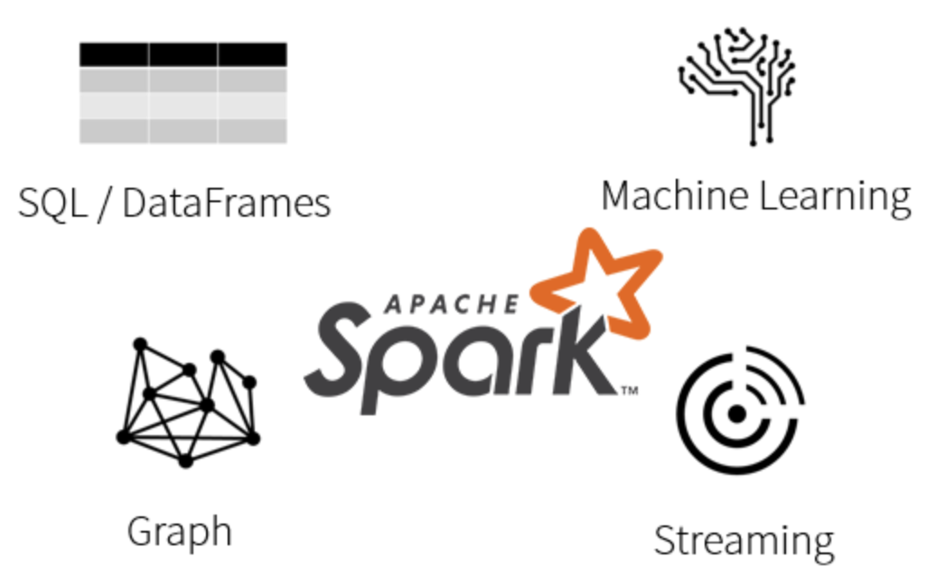
Spark
Open source Apache project
Distributed computation framework for executing code in parallel across many different machines in order to analyze large-scale data sets
Spark is data and environment agnostic.
Native high-level APIs in Scala, Python, R, and Java
Comes with useful tools, e.g.:
Spark SQL for SQL and structured data processing
MLlib for machine learning
GraphX for graph processing
Spark Streaming
Notes:
Environments: Yarn, Docker, EC2, Mesos, OpenStack, Databricks (our favorite), Digital Ocean, and much more...
Data Sources: Hadoop HDFS, Casandra, Kafka, Apache Hive, HBase, JDBC (PostgreSQL, MySQL, etc), CSV, JSON, Amazon S3, ElasticSearch, Parquet, and much, much more...

Slide 3
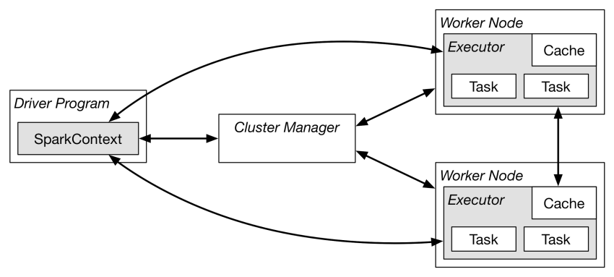
Spark Components
All programs run as a JVM
Master (cluster manager) allocates resources available across applications
Acquires executors on cluster nodes - process run compute tasks, cache data
Sends code to the executors
Sends tasks for the executors to run

Slide 4
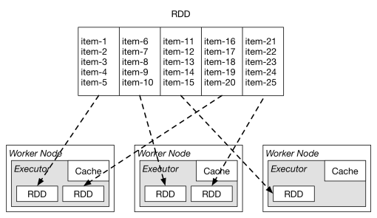
Resilient Distributed Datasets (RRDs)
Spark’s primary abstraction is a distributed collection of items called a Resilient Distributed Dataset (RDD):
Immutable
Resilient
able to recompute missing or damaged partitions due to node failures
Distributed
data residing on multiple nodes in a cluster
Enable parallel operations on collections
dataset is a collection of partitioned data
DataFrames, Datasets & SQL provide the higher level abstraction over RDDs
Notes:
RDDs are like a building block higher level things work with

Slide 5
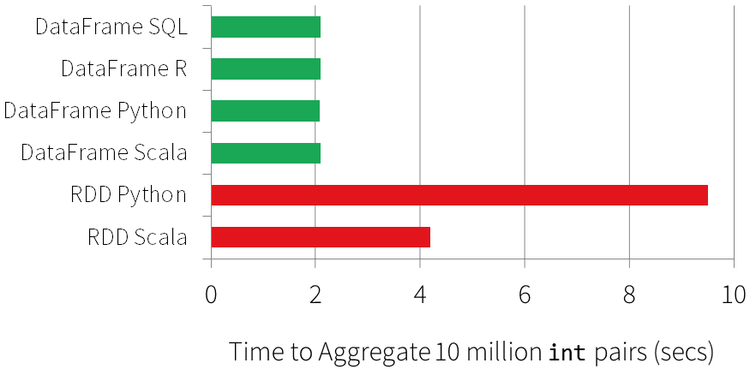
RDDs, DataFrames, and Languages
With the older RDD API, there are significant differences with each language's implementation, namely in performance.
With the newer DataFrames API, the performance differences between languages are nearly nonexistence (especially for Scala, Java & Python).
API gap for each language is rapidly closing, especially between Spark 1.x and 2.x.
*Figure from DataBricks Spark Programming Guide

Slide 6

PySpark
PySpark is the native Python API for working with Spark
Supported as part of the main Spark project
It works by wrapping a native Python application outside of the JVM then communicates with the JVM

Slide 7
SparkContext/SparkSession
The SparkContext object tells spark how to access a cluster
It is required for every Spark program
To build a SparkContext you need to build a SparkConf that contains information about your application
Only one SparkContext may be active per JVM
stop() must be called on the active SparkContext before creating a new one
In the Python or Scala shell this is the sc variable, which is created automatically
In Spark 2.0+, SparkSession encapsulates SparkContext and others

Slide 8
Initializing a SparkContext/SparkSession
Start by telling your application where your Spark cluster is
Need to tell it what the name of your application is (for tracking)
In a spark shell or Zeppelin the SparkContext is created for you
from pyspark import SparkContext, SparkConf
conf = SparkConf().setAppName(appName).setMaster(master)
# appname = name of thing, master = YARN cluster URL
sc = SparkContext(conf=conf)
# for a SparkSession in Spark versions 2+
from pyspark.sql import SparkSession spark = SparkSession.builder.appName("Python Spark SQL basic example")\ .config("spark.some.config.option", "some-value") \ .getOrCreate()
# http://spark.apache.org/docs/latest/configuration.html for spark config options

Slide 9
Submitting Spark Jobs
spark-submit # Run application locally on 8 cores ./bin/spark-submit --master local[8] foo.py\ # Run on a Spark standalone cluster in client deploy mode ./bin/spark-submit --master spark://207.184.161.138:7077 --executor-memory 20G --total-executor-cores 100 foo.py
bin/spark-submit will also read configuration options from conf/spark-defaults.conf, e.g::
spark.master spark://5.6.7.8:7077 spark.executor.memory 4g spark.eventLog.enabled true spark.serializer org.apache.spark.serializer.KryoSerializer

Slide 10
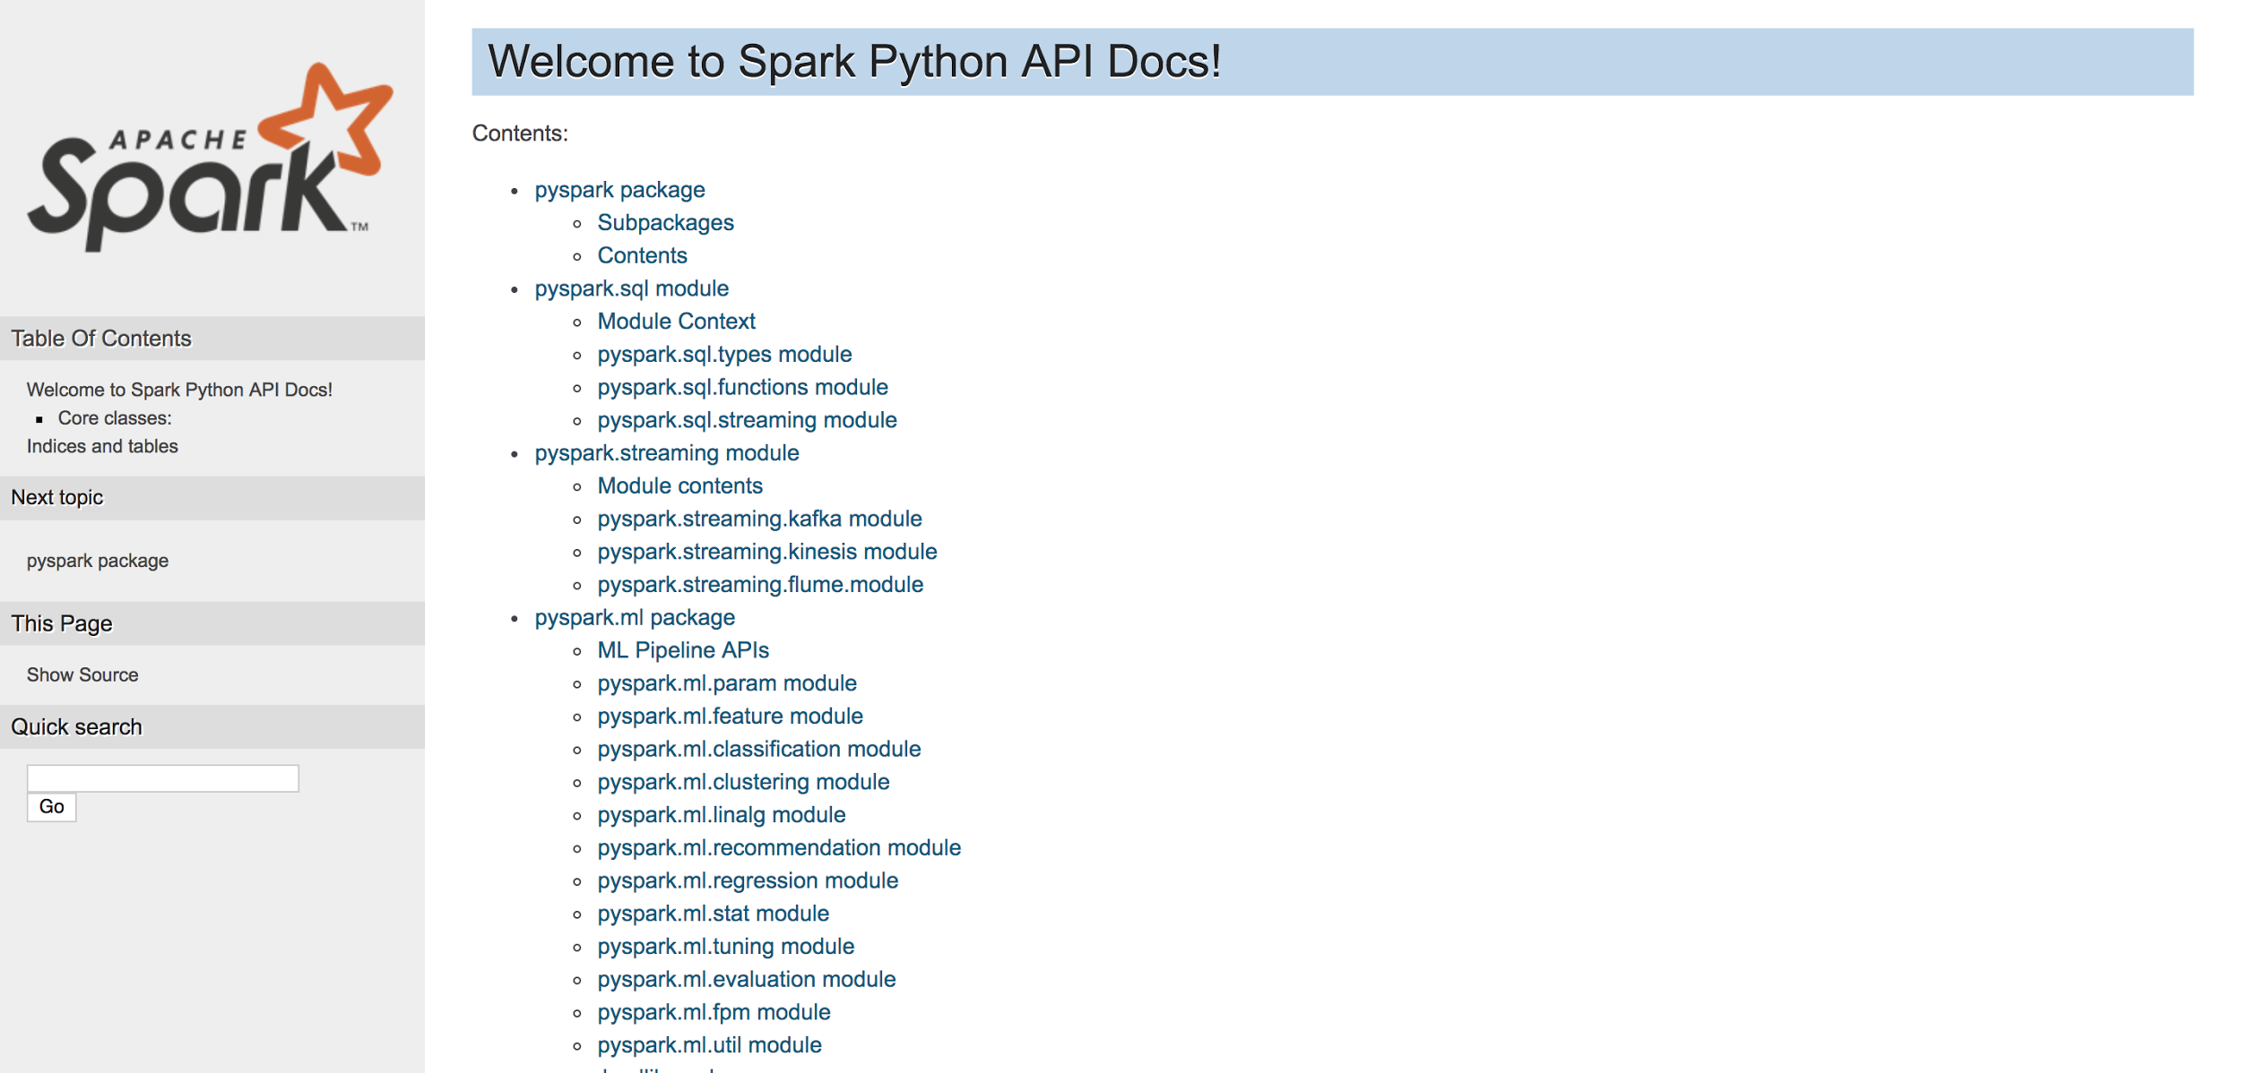
Spark API
https://spark.apache.org/docs/latest/api.html
Notes:
Go and find SparkSession and or SparkContext and take a look

Slide 11
Parallelized Collections (RDDs)
There are two ways to create RDDs:
parallelizing an existing collection in your driver program, or
referencing a dataset in an external storage system, such as a shared filesystem, HDFS, HBase, or any data source offering a Hadoop InputFormat.
data = [1, 2, 3, 4, 5] distData = sc.parallelize(data)
Once created, the distributed dataset (distData) can be operated on in parallel. For example, we can call distData.reduce(lambda a, b: a + b) to add up the elements of the list.
Notes:
Parallelized collections are created by calling SparkContext’s parallelize method on an existing iterable or collection in your driver program.
The elements of the collection are copied to a distributed dataset that can be operated on in parallel

Slide 12
Parallelized Collections (RDDs)
One important parameter for parallel collections is the number of partitions to cut the dataset into. Spark will run one task for each partition of the cluster.
Typically you want 2-4 partitions for each CPU in your cluster.
Normally, Spark tries to set the number of partitions automatically based on your cluster.
However, you can also set it manually by passing it as a second parameter to parallelize (e.g. sc.parallelize(data, 10))

Slide 13
Lab 1: PySpark Command Line Interaction
Let’s Start up a Spark Shell (pyspark if in path)
Create an RDD (e.g. as in previous slides)
Look at Spark API and try some command line interactions
To get set-up with our docker image that has spark and everything installed, see: https://github.com/MinerKasch/training-docker-pyspark

Slide 14
Creating DataFrames
With a SparkSession, DataFrames can be created from an existing RDD, from a Hive table, or from Spark data sources
example from JSON file:
# spark is an existing SparkSession df = spark.read.json("examples/src/main/resources/people.json") # Displays the content of the DataFrame to stdout df.show() # +----+-------+ # | age| name| # +----+-------+ # |null|Michael| # | 30| Andy| # | 19| Justin| # +----+-------+
Notes:
you can also add parameter for partitioning e.g. minPartitions=128

Slide 15
Creating DataFrames
From a local CSV df = spark.read.csv("some/csv/file/people.csv")
From S3: df = spark.read.parquet("s3://path/to/parquet/file.parquet")
From HDFS: df = spark.read.text(“hdfs://data/2017/*/*/*.txt”)
From a table: df2 = spark.table("table1")

Slide 16
Transformations And Actions
Transformations
Always return a DataFrame
Are lazy
map is a transformation that passes each dataset element through a function and returns a new RDD representing the results
Actions
Return a value to the driver program after running a computation on the dataset
Are eager
reduce is an action that aggregates all the elements of the RDD using some function and returns the final result to the driver program
Notes:
Two types of Operations are supported on RDDs
The transformations are only computed when an action requires a result to be returned to the driver program.
This design enables Spark to run more efficiently. For example, we can realize that a dataset created through map will be used in a reduce and return only the result of the reduce to the driver, rather than the larger mapped dataset.

Slide 17
Laziness
Transformations being lazy means:
Do NOT compute their results right away
Just remember the transformations applied to some base dataset
Only computed when an action requires a result to be returned
Most importantly, it allows the framework to automatically apply various optimizations

Slide 18
Some Actions
Method | Description
collect() | Return all the elements of the dataset as an array at the driver program.
count() | Return the number of elements in the dataset.
first() | Return the first element of the dataset (similar to take(1)).
take(n) | Return an array with the first n elements of the dataset.
reduce(f) | Aggregate the elements of the dataset using a function f (which takes two arguments and returns one). The function should be commutative and associative so that it can be computed correctly in parallel.
takeSample(wr, n) | Return an array with a random sample of n elements of the dataset, with or without replacement, as indicated by the boolean parameter ‘wr’.

Slide 19
Some Transformations
Method | Description
map(f) | Return a new distributed dataset formed by passing each element of the source through a function f.
filter(f) | Return a new dataset formed by selecting those elements of the source on which f returns true.
flatMap(f) | Similar to map, but each input item can be mapped to 0 or more output items (so f should return a Seq rather than a single item).
sample(wr, p) | Sample a fraction of the data, with or without replacement.
distinct() | Return a new dataset that contains the distinct elements of the source dataset.
groupBy(cols) | Return a dataset of grouped items

Slide 20
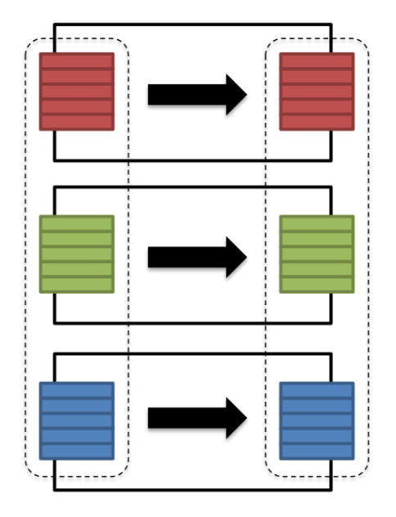
Wide vs Narrow Transformations
Narrow Transformations are able to perform the computation using only the data contained within the partition of data assigned to it.
Examples include:
filter(..)
drop(..)
coalesce()

Slide 21
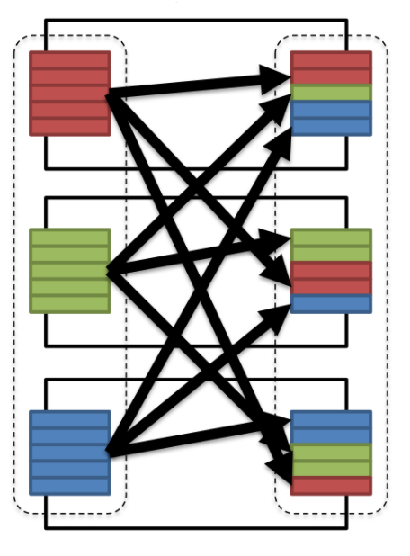
Wide vs Narrow Transformations
Wide Transformations are those type of transformations that require comparing data in multiple partitions.
Examples include:
distinct()
groupBy(..).sum()
repartition(n)
In order to compare data between two partitions a shuffle operation is required

Slide 22
Shuffles
A shuffle operation is triggered when data needs to move between executors.
For example, in order to group by color it will serve us best if...
all the reds are in one partitions
all the blues are in a second partition
all the greens are in a third
From there we can easily sum/count/average all of the reds, blues and greens.

Slide 23
Shuffles
Data that is "shuffled" is in a format known as the Tungsten Binary Format.
This is also the same format that is stored in RAM when cached.
This one format means Spark can move data from memory, to disk, across the network and back into memory in one single, highly-optimized, format.
Spark also executes as many operations as possible on a single partition of data (“Pipelining”)
Once a single partition of data is read into RAM, Spark will combine as many narrow operations as it can
By avoiding all the extra network and disk IO, Spark can easily out-perform traditional MapReduce applications.
Notes:
Compare to MapReduce where:
0. Data is read from disk
0. A single transformation takes place
0. Data is written to disk
0. Repeat steps 1-3 until all transformations are completed

Slide 24
One more important thing: cache()
The ability to cache data is fundamental to achieving high performance with Apache Spark.
By default, each transformed RDD may be recomputed each time you run an action on it.
You can tell Spark to cache an RDD, keep the elements around on the cluster for much faster access the next time you query it.

Slide 25
cache()
The operation cache() simply marks the DataFrame as cached.
The cache won't be materialized until all the data is read in.
Executing a count() is a very common way of forcing the cache to materialize.
somedataframe .cache() # Mark the DataFrame as cached .count() # Materialize the cache

Slide 26
Now what?
Let’s take a closer look at some common transformations and actions to do on RDDs/DataFrames in pySpark..

Slide 27
table()
Returns the specified table as a DataFrame
df.createOrReplaceTempView("table1")
df2 = spark.table("table1") sorted(df.collect()) == sorted(df2.collect())
createOrReplaceTempView()
Creates or replaces a local temporary view with this DataFrame.
The lifetime of this temporary table is tied to the SparkSession that was used to create this DataFrame.

Slide 28
saveAsTable()
Saves the content of the DataFrame as the specified table.
In the case the table already exists, behavior of this function depends on the save mode, specified by the mode function (default to throwing an exception).
append: Append contents of this DataFrame to existing data.
overwrite: Overwrite existing data. (When mode is Overwrite, the schema of the DataFrame does not need to be the same as that of the existing table.)
error: Throw an exception if data already exists.
ignore: Silently ignore this operation if data already exists.
saveAsTable(name, format=None, mode=None, partitionBy=None, **options)

Slide 29
select()
Selects just the specified columns from an RDD/DataFrame
data= sc.textFile(”hdfs://data/books/*.txt")
title_author_data = data.select([“title”,”author”])

Slide 30
Python’s Lambda
In [1]: def apply_twice(myf, value):
...: return myf(myf(value))
...:
In [2]: apply_twice(lambda x : x + 1, 9)
Out[2]: 11
In [3]: apply_twice(lambda x : x * 2, 9)
Out[3]: 36
Lambda is shorthand for buildings one-line functions
Used a lot to pass in a quick function as a parameter
Functionally equivalent to defining a function with def
In [4]: def double(x):
...: return x * 2
...:
In [5]: apply_twice(double, 9)
Out[5]: 36

Slide 31
map()
Map takes a function as a parameter
Applies that function to every element in the RDD
Gives you back and RDD with the results
data = sc.textFile(”hdfs://data/books/*.txt")
yelling = data.map(lambda s: s.upper())
some_yelling = data.map(lambda s: s.upper() if len(s) % 2 == 0 else s.lower())

Slide 32
flatMap()
Like map, but the function returns a list of things not just one thing
It takes each thing in the list and “flattens” it into one cell each
Note that lists can have zero elements
data= sc.textFile(”hdfs://data/books/*.txt")
words= lines.flatMap(lambda s: s.split())

Slide 33
foreach()
Identical to map except that it doesn’t collect results or return anything
Useful for doing something with “side effects” a bit more efficiently than map
data= sc.textFile(”hdfs://data/books/*.txt")
lines.foreach(lambda s: write_to_db(‘postgres’, s.lower()))

Slide 34
collect()
Pulls data from the RDD and pulls it into Python’s local memory
Each cell turns into an element in a list
Good as a last step to return some results to an application or something like that
Be careful on how much data you are bringing back!
mylocalpythondata = myrdd.collect()

Slide 35
count()
Simply count how many rows are in the data
Returns back the number in Python (i.e., an action not a transformation)
sc.parallelize([2, 3, 4]).count()

Slide 36
filter()
Takes a function that returns True or False
If the result of the function is True, it keeps it, otherwise it drops it
lines = sc.textFile(" hdfs://data/books/*.txt")
bigfoot = lines.filter(lambda s: ’big foot’ in s.lower())

Slide 37
take()
Gives you N arbitrary elements from the RDD
Arbitrarily picks a partition and pulls data until N is reached
They are likely to be in contiguous order
Useful for seeing if data was loaded and what might be in the RDD
>>> sc.parallelize([2, 3, 4, 5, 6]).take(2)
[2, 3]

Slide 38
reduce()
Reduce takes a two-parameter function as a parameter
Applies this function to the first two elements, then the result of that with the third element, then the result of that with the fourth element, …
Returns the result to the client (action)
lines = sc.textFile(" hdfs://data/books/*.txt")
wc = lines.map(lambda s: len(s.split())).reduce(lambda a, b: a + b)

Slide 39
min() and max()
These functions return the minimum value and maximum value in the RDD
It’ll by default use whatever object’s < operator
You can specify a custom key
>>> rdd = sc.parallelize([1.0, 5.0, 43.0, 10.0])
>>> rdd.max()
43.0
>>> rdd.max(key=str)
5.0

Slide 40
mean()
Computes the average of the RDD and returns that back
>>> sc.parallelize([1, 2, 3]).mean()
2.0

Slide 41
stdev()
Computes the standard deviation of the RDD and returns that back
>>> sc.parallelize([1, 2, 3]).stdev()
0.816

Slide 42
agg(*expr)
Compute aggregates and returns the result as a DataFrame.
The available aggregate functions are avg, max, min, sum, count.
Parameters: exprs – a dict mapping from column name (string) to aggregate functions (string), or a list of Column
>>> gdf = df.groupBy(df.name) >>> sorted(gdf.agg({"*": "count"}).collect()) [Row(name=u'Alice', count(1)=1), Row(name=u'Bob', count(1)=1)]

Slide 43
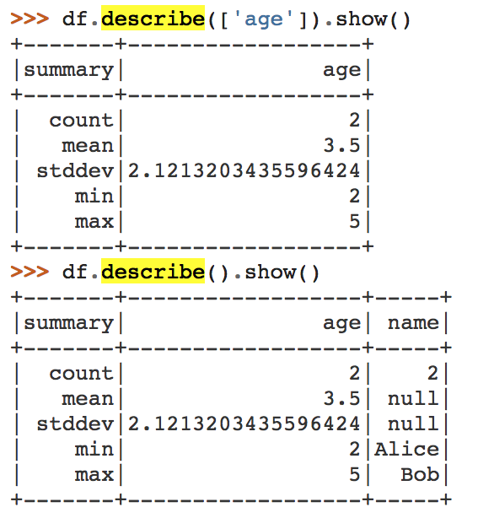
describe()
Computes statistics for numeric and string columns.
This includes count, mean, stddev, min, and max. If no columns are given, this function computes statistics for all numerical or string columns.

Slide 44
sample()
sample(withReplacement, fraction, seed)
Pull out a random sample of a data set
Returns that as a new RDD
myrdd.sample(False, .05)

Slide 45
takeSample()
takeSample(withReplacement, num, seed=None)¶
Pull out a random sample of a data set, except gives you an exact number of elements
Pulls it into local memory, not into a new RDD
myrdd.takeSample(False, 1000)

Slide 46
top()
top(num, key=None)
Retrieves the top N items from the RDD
Pulls it into local memory, not into a new RDD
By default it’ll use <
You can pass it a key to determine how it should calculate “top”
myrdd.top(10)

Slide 47
union()
Combines two RDDs into one new RDD
Very efficient because it doesn’t actually do anything mechanically
Note: Spark is happy to have heterogeneous RDDs, be careful of types
newrdd = rdddocs1.union(rdddocs2)
Notes:
like concat

Slide 48
intersect()
Pass an RDD a second RDD
Gives a new RDD with just the elements that are shared in common
newrdd = rdddocs1.intersect(rdddocs2)

Slide 49
coalesce()
Repartitions an RDD into a new, lower number of partitions
Efficient because it just combines some partitions into one without doing a shuffle
myrdd.coalesce(20)

Slide 50
repartition()
Same as coalesce, but does a shuffle to redistribute the data
Use this if you are worried about skew or if you are going up in number of partitions
myrdd.repartition(20)

Slide 51
distinct()
Runs over the RDD and removes all duplicates
Duplicates are defined as ”==“ returning true
sc.parallelize([1, 1, 2, 3]).distinct()

Slide 52
histogram()
Counts how many items are in between bucket boundaries you provide.
rdd = sc.parallelize(range(51))
rdd.histogram([0, 5, 25, 50])
([0, 5, 25, 50], [5, 20, 26])

Slide 53
sortBy()
sortBy(keyfunc, ascending=True, numPartitions=None)
Takes in a function that returns some sort of comparable object
Sorts the data set by that
Very expensive over large data sets!
Can sort ascending or descending
Gives you the opportunity to change the number of partitions
tmp = [('a', 1), ('b', 2), ('1', 3), ('d', 4), ('2', 5)]
sc.parallelize(tmp).sortBy(lambda x: x[0]).collect()
[('1', 3), ('2', 5), ('a', 1), ('b', 2), ('d', 4)]
sc.parallelize(tmp).sortBy(lambda x: x[1]).collect()
[('a', 1), ('b', 2), ('1', 3), ('d', 4), ('2', 5)]

Slide 54
groupBy()
Groups the DataFrame using the specified columns, so we can run aggregation on them.
On RDDs, spark creates a new RDD with pairs: first element is the group, second is a list of all those with that group
df.groupBy().avg().collect() [Row(avg(age)=3.5)]
sorted(df.groupBy('name').agg({'age': 'mean'}).collect()) [Row(name=u'Alice', avg(age)=2.0), Row(name=u'Bob', avg(age)=5.0)]

Slide 55
join()
Takes two Pair RDDs and does a “sql inner join”
Creates a new Pair RDD with the key is the foreign key, then the value is a 2-item tuple with the values from each data set
Also, see leftOuterJoin, rightOuterJoin, fullOuterJoin for different types of joins
x = sc.parallelize([("a", 1), ("b", 4)])
y = sc.parallelize([("a", 2), ("a", 3)])
sorted(x.join(y).collect())
[('a', (1, 2)), ('a', (1, 3))]

Slide 56
Lab 2: PySpark Intro
Let’s make sure we have Jupyter Notebook running and do Lab 2 there.
Again, see https://github.com/MinerKasch/training-docker-pyspark for instructions.

Slide 57
User Defined Functions
https://docs.databricks.com/spark/latest/spark-sql/udf-in-python.html
To use a spark user defined function as part of e.g. an agg: def squared(s): return s * s sqlContext.udf.register("squaredWithPython", squared)

Slide 58
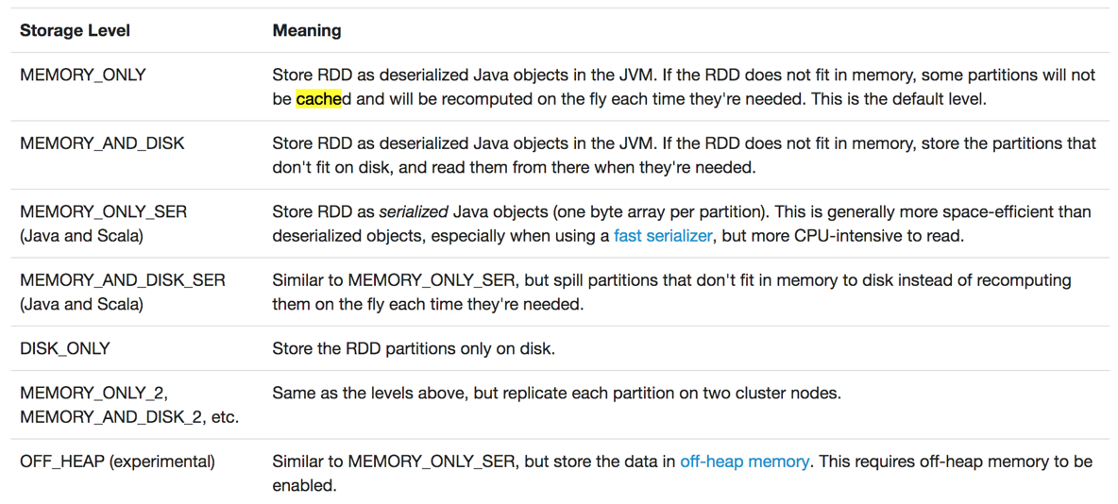
Persisting and Saving DataFrames
persist()
Similar to cache, but has more options. Particularly for spilling to disk.
Might be useful for long-running queries that might have nodes die

Slide 59
Which storage level?
Spark’s storage levels are meant to provide different trade-offs between memory usage and CPU efficiency. We recommend going through the following process to select one:
If your RDDs fit comfortably with the default storage level (MEMORY_ONLY), leave them that way. This is the most CPU-efficient option, allowing operations on the RDDs to run as fast as possible.
If not, try using MEMORY_ONLY_SER and selecting a fast serialization library to make the objects much more space-efficient, but still reasonably fast to access. (Java and Scala)
Don’t spill to disk unless the functions that computed your datasets are expensive, or they filter a large amount of the data. Otherwise, recomputing a partition may be as fast as reading it from disk.

Slide 60
Persisting and Saving DataFrames
saveAs()
Bunch of functions called .saveAs*
Spark will convert each item to a string with str(), separate with newlines
Can take HDFS, S3 as output paths
Can take a local file system path, but think about where you are!
Takes a path to a directory. Each partition will write a file.
distData = sc.saveAsTextFile(“hdfs://data/out/")

Slide 61
Broadcast Variables
Create read-only variables that are shared across the job
In most cases are shared once per node
Whole thing needs to be able to be stored in memory
Useful for sharing reference data or configuration parameters
>>> broadcastVar = sc.broadcast([1, 2, 3])
<pyspark.broadcast.Broadcast object at 0x102789f10>
>>> broadcastVar.value
[1, 2, 3]

Slide 62
Accumulators
Similar to broadcast variables in that they are shared
However, accumulators are only counters
You can increment them wherever in your code
The result can be extracted or viewed in the management UI
Good for keeping track of things on the side, like number of errors
>>> accum = sc.accumulator(0)
>>> accum
Accumulator<id=0, value=0>
>>> sc.parallelize([1, 2, 3, 4]).foreach(lambda x: accum.add(x))
>>> accum.value
10

Slide 63
SparkSQL
The sql function on a SparkSession enables applications to run SQL queries programmatically and returns the result as a DataFrame.
An easy way to use SQL/HiveQL syntax
Backed by Spark’s RDDs and execution engine
Lets you mix SQL and the native Spark API in Java, Scala, or Python
df.createOrReplaceTempView("people") sqlDF = spark.sql("SELECT * FROM people") sqlDF.show() # +----+-------+ # | age| name| # +----+-------+ # |null|Michael| # | 30| Andy| # | 19| Justin| # +----+-------+

Slide 64
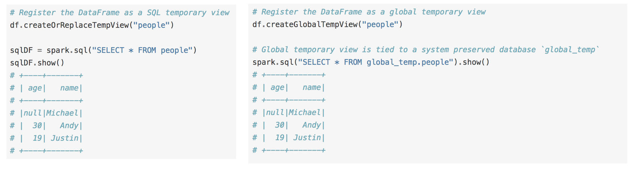
Registering a DF as a table
Before working with a DataFrame in SQL, you have to register it as a temp table
Can also register it globally, so that it persists across sessions

Slide 65
Why SparkSQL?
Helps you solve some of the easier structured problems quickly
Mixing SQL and native API doesn’t force you to use one or the other
Can replace existing SQL workloads and hopefully be faster
Spark’s engine is well suited for interactive ad-hoc analysis, which other systems (such as MapReduce) struggle with
Integrate with BI tools that talk SQL

Slide 66
Why not SparkSQL?
Some similar arguments to Spark vs. MapReduce where Spark may fall short:
Longer running queries
Very large scale … might want to use Hive
Data should probably be structured or SQL is going to get convoluted
SQL was built for nicely structured data, might not be very elegant for nested or denormalized data

Slide 67
Lab 3: SparkSQL Interaction
In our Jupyter notebooks, let’s open Lab 3.

